Slide 1
Chapter 15
Binary Logistic Regression

Slide 2
Learning Objectives
Explain the concept of logistic regression
Describe the assumptions of logistic linear regression
Describe statistical significance in logistic regression
Explain how to frame hypotheses in logistic regression
Explain how the research problem is formulated for logistic regression

Slide 3
Demonstrate the steps used in SPSS to execute logistic regression
Explain how to analyse and interpret the SPSS outputs for logistic regression
Examine the assumptions of logistic regression
Report the final results of logistic regression

Slide 4
Introduction
Logistic regression is used to predict the probability of a dependent variable based on nominal scale.
In logistic regression (commonly known as binary logistic regression), the dependent variable is dichotomous in nature with two distinct categories, whereas independent variables are either categorical or continuous in nature.
Logistic regression is predictive in nature and describes the relationship among one dependent (non-metric) and more than one independent variable(s) measured at metric and/or non-metric scales.
A logistic regression model consists of regression coefficients and is used to predict the logit transformation of the probability of binary outcome variable.

Slide 5
Assumptions for Applying Logistic Regression
Number of dependent and independent variables: The dependent variable is binary in nature. One or more independent variables should be used in analysis that indicate the theoretical or conceptual relationship with a dependent variable.
Measurement scale: The dependent variable measured at nominal scale consists of at least two distinct categories, whereas independent variable(s) is measured at either metric (interval or ratio) or non-metric (nominal) scale.

Slide 6
Independent observations: The observed values or responses collected in the study must be independent to each other for more accurate prediction.
Linear relationship: The logistic regression assumes linear association among continuous independent variables with little or no multicollinearity.
Sample size: The general principle to decide the sample size is the requirement of minimum 10 subjects corresponding to probability of least frequent outcome in the study.

Slide 7
Summary of Assumptions
Table 15.1. Summary of Assumptions for Logistic Regression
Assumption | Examine Approach | Measures/Tests
One dichotomous dependent and more than one independent variables | Methodology based | –
Metric and non-metric data for variables | Scale of measurement | –
Independent observation | Methodology based | –
Linear relationship | Graphical method | Scatter plot
Absence of outliers | Graphical method | Box and whisker plot

Slide 8
Probabilistic Logistic Regression Model
The logistic regression is same as linear regression except that this technique is used to predict whether outcome is true/false instead of predicting the value of dependent variable.
Table 15.2. Logistic Regression: Relationship
Temp. | 1.3 | 3.4 | 2.1 | 2.0 | 1.7 | 2.5 | 2.6 | 1.4 | 2.5
Snowfall | 1 | 0 | 0 | 1 | 1 | 0 | 0 | 1 | 0
Temp. | 3.6 | 1.5 | 1.3 | 4.2 | 1.9 | 3.1 | 2.8 | 1.8 | 2.4
Snowfall | 0 | 1 | 1 | 0 | 1 | 0 | 0 | 1 | 1

Slide 9
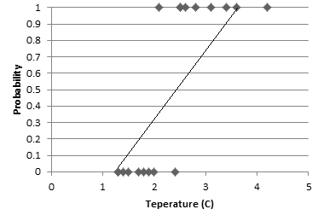
Figure 15.1a. Scatter Plot: Logistic Regression
Figure 15.1b. Scatter Plot: Line Fit in Logistic

Slide 10
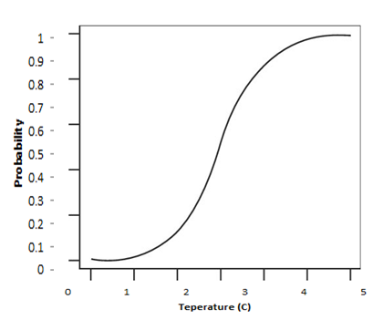
A Sigmoid (S-shaped)
Logistic regression fits the data with maximum likelihood method.

Slide 11
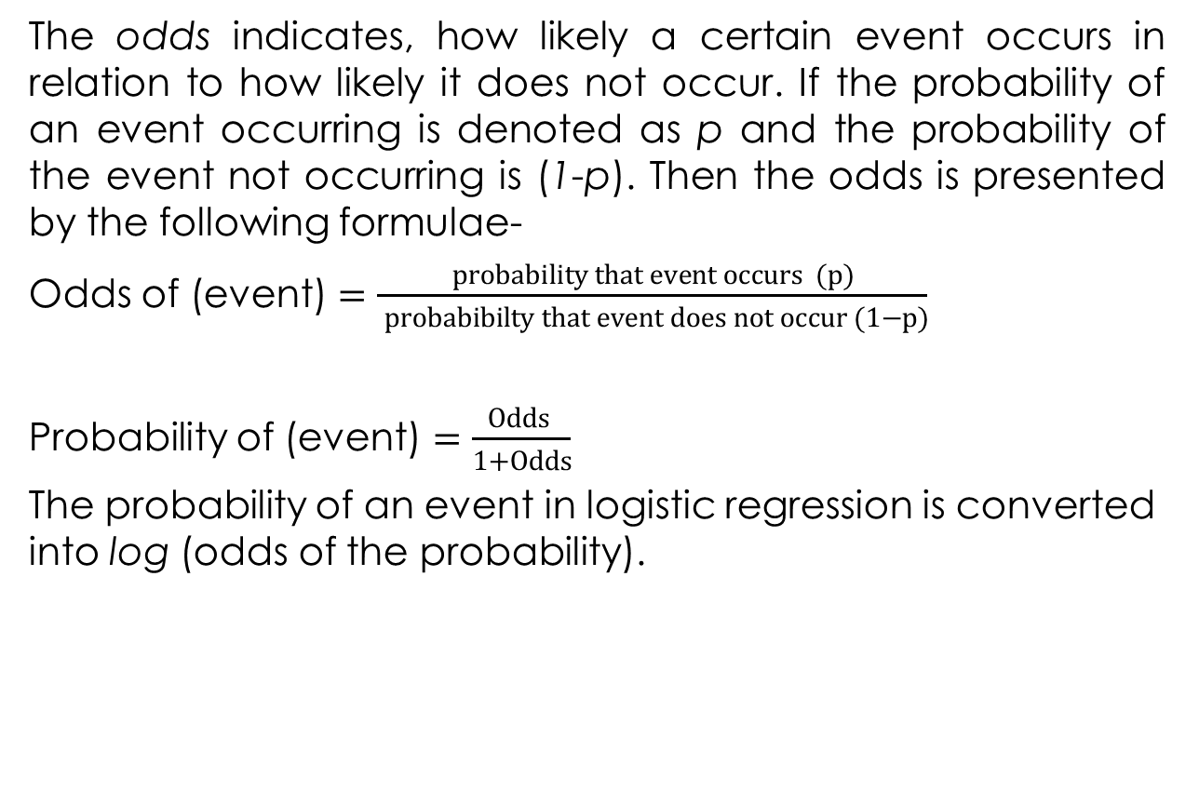
Odds

Slide 12
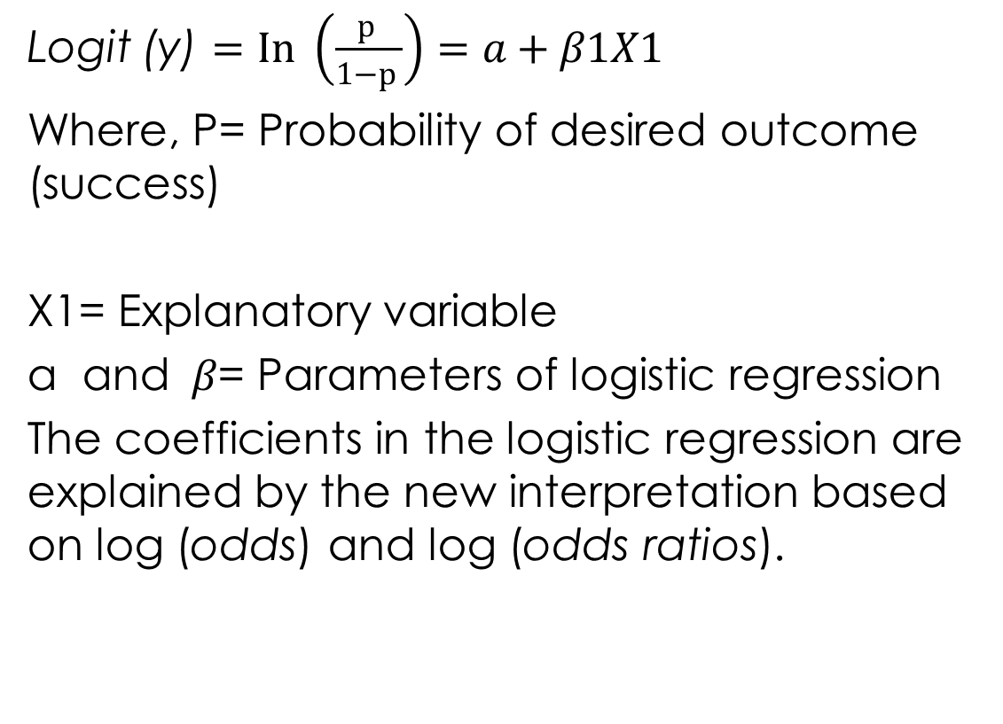
Logistic Regression Model

Slide 13
Significance of Logistics Regression
Hosmer and Lemeshow (H–L) statistic indicates the overall model-fit.
The well-fitting logistic model depicts non-significance on the H–L goodness-of-fit based on probabilistic value at preset LoS.
Receiver operating characteristics (ROC) curve is also used to examine goodness-of-fit by measuring sensitivity (true positive) and specificity (true negative) for the all the possible cut-off points.
The area under curve ranges from 0.5 to 1.0 and larger value is the indication of better fit.

Slide 14
Framing Hypothesis in Logistic Regression
Hypothesis for Model-Fit
Null hypothesis H₀: β = 0
(The regression model does not predict significantly the outcome variable as compared to base/null model.)
Alternative hypothesis H_{a}: β ≠ 0
(The regression model predicts significantly the outcome variable as compared to base/null model.)

Slide 15
Hypothesis for Relationship between the Variables
Null hypothesis: There is no significant effect of each predictor on the outcome variable.
Alternative hypothesis: There is significant effect of each predictor on the outcome variable.

Slide 16
Hypothesis for Actual Outcomes
Null hypothesis: No difference exists between the observed and model predicted values.
Alternative hypothesis: Significant difference exists between observed and model predicted values.

Slide 17
Research Problem and Test Technique
Data set knee_replacement is used to conduct binary logistic regression consisting of four explanatory variables based on metric and non-metric (gender, age, obesity and calcium range) scales and one dependent variable with two distinct categories (slow or fast recovery).
The explanatory variables include gender and obesity measured at nominal scale, whereas age and calcium level were measured at ratio scale.

Slide 18
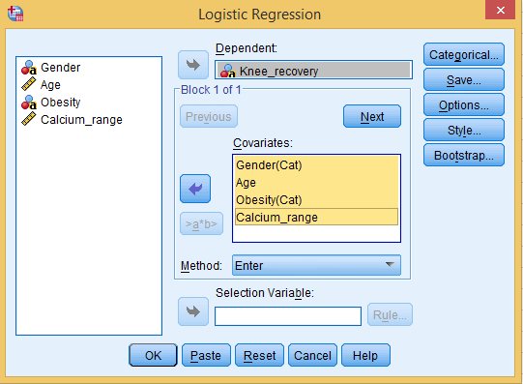
Placing Dependent and Independent Variables
Exhibit 15.1. Use knee_replacement.sav » Menu bar » analyse » Regression » Logistic Regression » Select Knee_recovery and transfer to Dependent box » Select Gender, Age, Obesity, and Calcium_range » Click on Categorical option

Slide 19
SPSS Path for Coding the Categorical Variables
Exhibit 15.2. Use Categorical option and select Gender (Indicator) » Click First option in Change Contrast » Click Change » Select Obesity (Indicator) » Click First option in Change Contrast » Click Change » Continue

Slide 20
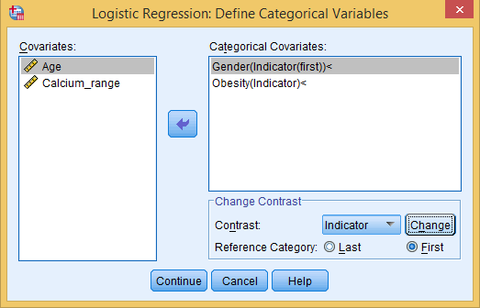
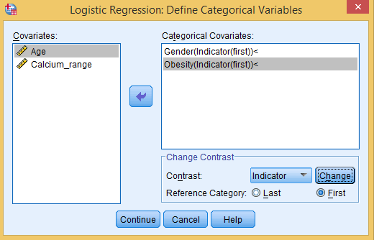
Figure 15.4a. Categorical Variable: Logistic Regression
Figure 15.4b. Categorical Variable: Reference Category

Slide 21
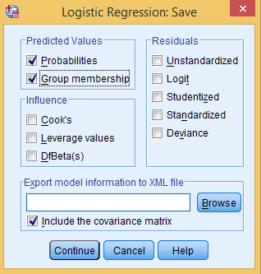
SPSS Path for Predicting the Probabilities and Group Membership

Slide 22
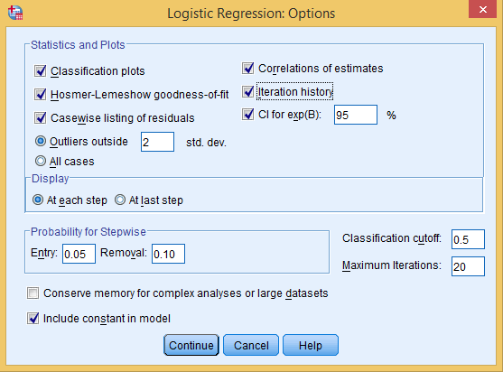
SPSS Path for Classification Plot and Goodness of Fit­
Exhibit 15.3. Click Options in main dialog box » Select Classification plots, Hosmer-Lameshow goodness of fit, Casewise listing of residuals, Correlation of estimates, Iteration history and CI for exp(B) » Continue

Slide 23
Interpreting the Outputs of Logistic Regression
Coding of Dependent Variable­
Table 15.3a. Internal Values for Outcome Variable
Original Value | Internal Value
Slow | 0
Fast | 1

Slide 24
Parameterization with Dummy Variables
Table 15.3b. Dummy Variable Coding
 |  | Frequency | Parameter Coding
 |  |  | (1) | (2)
Obesity | High | 24 | 0.000 | 0.000
 | Medium | 26 | 1.000 | 0.000
 | Low | 10 | 0.000 | 1.000
Gender | Male | 39 | 0.000
 | Female | 21 | 1.000

Slide 25
Magnitude of Unexplained Variance
Table 15.3c. Unexplained Variance
Iteration |  | −2 Log Likelihood | Coefficients
 |  |  | Constant
Step 0 | 1 | 78.861 | −0.533
 | 2 | 78.859 | −0.547
 | 3 | 78.859 | −0.547

Slide 26
Classification of Cases
Table 15.3d. Classification Table
Classification of Cases^{a,b}
 | Observed |  | Predicted
 |  |  | Knee_recovery |  | Percentage Correct
 |  |  | Slow | Fast
Step 0 | Knee_recovery | Slow | 38 | 0 | 100.0
 |  | Fast | 22 | 0 | 0.0
 | Overall Percentage |  |  |  | 63.3
ªConstant is included in the model.
^{b}The cut-off value is 0.500.

Slide 27
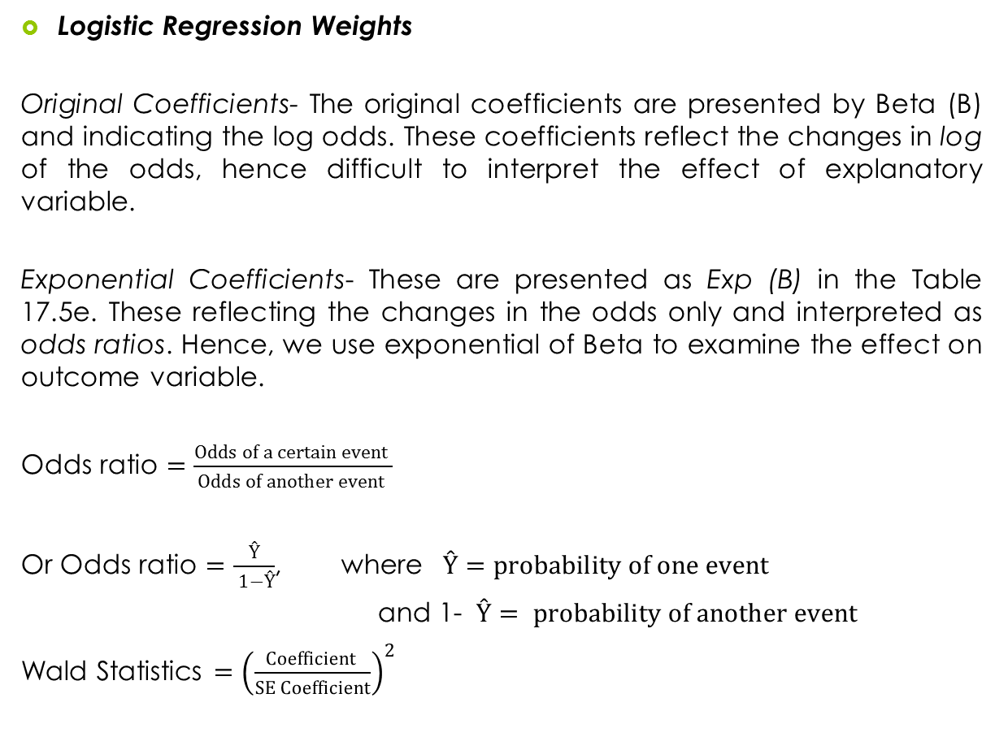

Slide 28
Table 15.3e. Variable in Equation
 |  | B | SE | Wald | df | Sig. | Exp(B)
Step 0 | Constant | −0.547 | 0.268 | 4.162 | 1 | 0.041 | 0.579

Slide 29
Variable Not in Equation
Table 15.3f. Variables Not Included in the Baseline Model
 |  |  | Score | df | Sig.
Step 0 | Variables | Gender(1) | 0.028 | 1 | 0.866
 |  | Age | 10.232 | 1 | 0.001
 |  | Obesity | 2.529 | 2 | 0.282
 |  | Obesity(1) | 0.629 | 1 | 0.428
 |  | Obesity(2) | 0.919 | 1 | 0.338
 |  | Calcium_range | 13.508 | 1 | 0.000
 | Overall statistics |  | 17.600 | 5 | 0.003

Slide 30
Interpretation of Block 1 with Enter Method
Step: The step indicates the results of a specific variable incorporated in the step.
Block: The results of all variables are entered.
Model: The results of the whole model.

Slide 31
Table 15.3g. Omnibus Tests of Model Coefficients
 |  | Chi-Square | df | Sig.
Step 1 | Step | 19.875 | 5 | 0.001
 | Block | 19.875 | 5 | 0.001
 | Model | 19.875 | 5 | 0.001
All the values are equal for different models as the same set of explanatory variables are incorporated into the analysis by using enter method in the logistic regression.

Slide 32
Goodness of Fit
Model Summary
Table 15.3h. Model Summary: Logistic Regression
Step | −2 Log Likelihood | Cox and Snell R Square | Nagelkerke R Square
1 | 58.984ª | 0.282 | 0.386
ªEstimation terminated at iteration number 5 because parameter estimates changes by less than 0.001.
It can be seen in Table 15.3h that the value of −2 Log likelihood has been reduced to 58.984 with a difference of 19.87 (78.861 − 58.984 = 19.87) with 5 degrees of freedom as compared to Block 0 model.
It can be concluded that 28 to 38 per cent of the variation in the knee recovery can be explained by the Model 1 based on these measures.

Slide 33
Table 15.3i. Hosmer and Lemeshow (H–L) Statistics
Step | Chi-Square | df | Sig.
1 | 4.017 | 8 | 0.856
H–L statistic is non-significance (Chi-Square 4.017, p > 0.05, 0.856) at 5 per cent LoS. Hence, we fail to reject the null hypothesis regarding no difference between the observed and model predicted values.

Slide 34
Classification Table
Table 15.3j. Classification of Cases
Classification Tableª
 | Observed |  | Predicted
 |  |  | Knee_recovery |  | Percentage Correct
 |  |  | Slow | Fast
Step 1 | Knee_recovery | Slow | 33 | 5 | 86.8
 |  | Fast | 11 | 11 | 50.0
 | Overall Percentage |  |  |  | 73.3
ªThe cut-off value is 0.500

Slide 35
1. Thirty-three cases are correctly classified into slow category, whereas five cases are predicted as fast recovery (misclassified). Hence, 86.8 per cent (33/38) is the predictive accuracy for slow recovery (consider diagonal values of the matrix).
2. Twenty-two cases and 11 cases are misclassified and predicted as slow category. Hence, 50 per cent is the accuracy (consider off-diagonal values of the matrix) for fast recovery.

Slide 36
Examine the Contribution of Prediction in Logistic Model
Table 15.3k. Regression Coefficients: Logistic Model
 |  | B | SE | Wald | df | Sig. | Exp(B) | 95% CI for Exp(B)
 |  |  |  |  |  |  |  | Lower | Upper
Step 1ª | Gender (1) | 0.101 | 0.695 | 0.021 | 1 | 0.885 | 1.106 | 0.283 | 4.320
 | Age | −0.114 | 0.056 | 4.122 | 1 | 0.042 | 0.892 | 0.799 | 0.996
 | Obesity |  |  | 0.645 | 2 | 0.724
 | Obesity(1) | 0.409 | 0.740 | 0.305 | 1 | 0.581 | 1.505 | 0.353 | 6.414
 | Obesity(2) | 0.730 | 0.945 | 0.597 | 1 | 0.440 | 2.076 | 0.326 | 13.234
 | Calcium_range | 0.794 | 0.322 | 6.093 | 1 | 0.014 | 2.213 | 1.178 | 4.159
 | Constant | −0.351 | 4.722 | 0.006 | 1 | 0.941 | 0.704
ªVariable(s) entered on Step 1: Gender, Age, Obesity, Calcium_range.

Slide 37
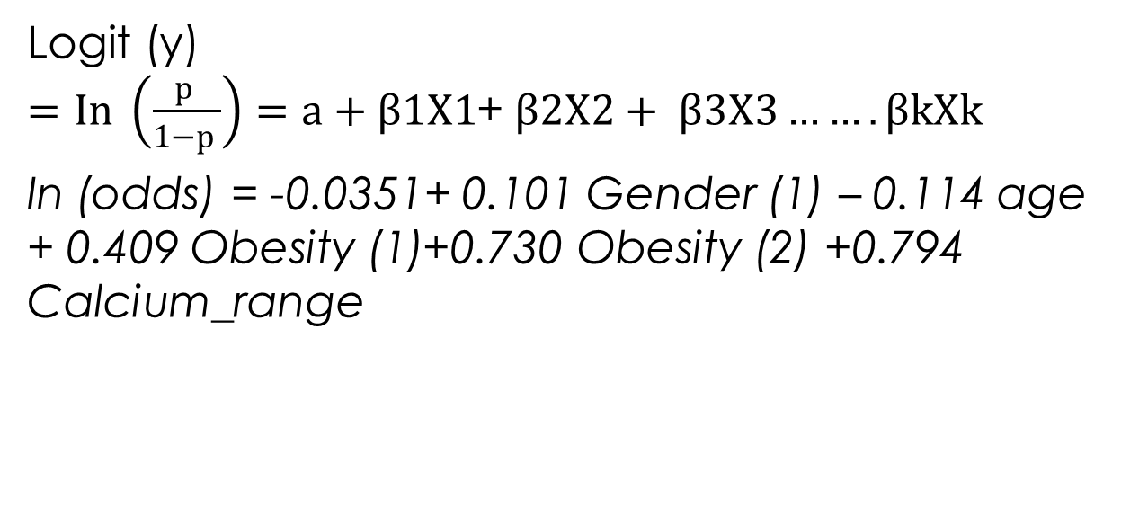
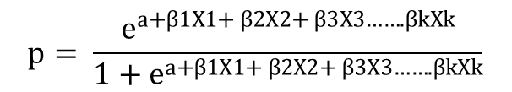
Logistic Model
In (odds)= -0.0351+ 0.101 female – 0.114 age + 0.409 medium weight +0.730 low weight +0.794 calcium range
Conversion of Odds into Probabilities

Slide 38
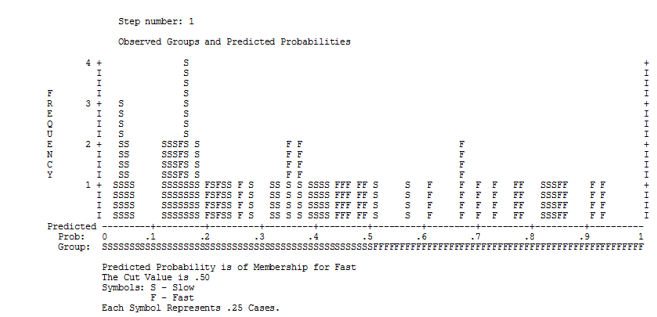
Classification Plot
A fit model indicates a U-shaped distribution of cases and resembles greater frequency of predictive probabilities belonging to the cases that are correctly classified at both ends.

Slide 39
Case-wise Analysis
Table 15.3l. Case-wise List
Case | Selected Statusª | Observed | Predicted | Predicted Group | Temporary Variable
 |  | Knee_recovery |  |  | Resid | ZResid
50 | S | F** | 0.150 | S | 0.850 | 2.385
53 | S | S** | 0.838 | F | −0.838 | −2.276
ªS: Selected; U: Unselected cases; **Misclassified cases.
^{b}Cases with studentized residuals greater than 2.000 are listed.

Slide 40
Cases 50 and 53 are identified as outliers. A Case 50 is observed in the category of ‘fast recovery’, whereas the predicted ones into ‘slow recovery’ group with probability of 15 per cent are to be in the target group.

Slide 41
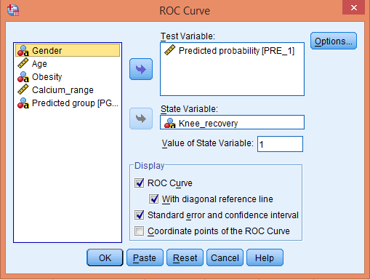
Validation of Logistic Regression Model
Exhibit 15.4. Use knee_replacement.sav » analyse » ROC » transfer Predicited probability [PRE_1] into test variable box » transfer Knee_recoverly state variable box » type 1 in Value of state variable box » select options ROC curve and with diagonal reference line » select » standard error and confidence interval » Press ok

Slide 42
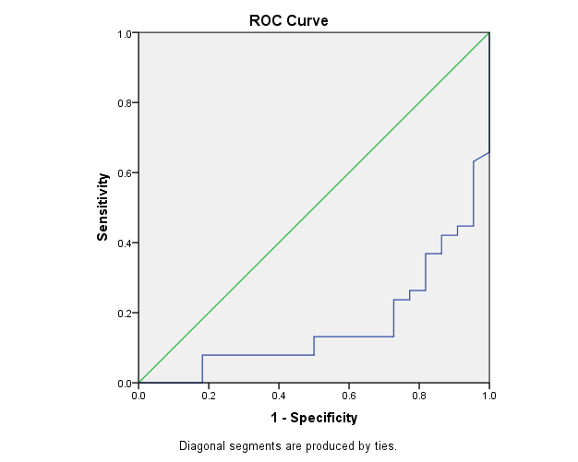
Validation of Logistic Regression
Table 15.4. Area under the ROC Curve
Test Result Variable(s): Predicted Probability
Area | Std. Error | Asymptotic Sig. | Asymptotic 95% Confidence Interval
 |  |  | Lower Bound | Upper Bound
0.163 | 0.052 | 0.000 | 0.061 | 0.265
The p-value (p < 0.5, p = 0.000) is less than 0.05. Hence, it is verified that the presented logistic model classifies the cases into slow and fast knee recoveries significantly.

Slide 43
Reporting the Final Results of Logistic Regression
The baseline or null model of logistic regression contains the highest unexplained variance (−2 Log likelihood is 78.861) and the overall statistics of Chi-Square is found significant (p < 0.05, p = 0.003, χ²= 17.600).
On the basis of p-value, two predictors namely age (10.232, p < 0.05, 0.001) and calcium level (13.508, p < 0.05, 000) are identified as significant variables in improving the predictive power of the logistic model as compared to the gender (0.028, p > 0.05, 0.866) and obesity (2.52, p > 0.05, 0.282).

Slide 44
On the basis of Wald statistics, we observed that calcium range in body (6.093, p < 0.05, 0.014) makes significant contribution in the knee recovery followed by the age (4.122, p < 0.05, 0.042) of the person. Whereas, gender (0.021, p > 0.05, 0.885) and obesity (0.645, p > 0.05, 0.724) are insignificant in contributing to the recovery speed in knee transplant.
On the basis of estimated regression coefficients, the knee recovery in females is 1.106 times higher than the male category.

Slide 45
Key Terms
-2 Log likelihood Beginning block Binary logistic regression Cox & Snell R Square Dummy variable Exponential Coefficients Heteroskedasticy Hosmer & Lemeshow (H-L) statistic Logit transformation Maximum likelihood method Nagelkerke R Square Natural logarithm of odds (In) Non-linear transformation | Odds Odds ratio Omnibus Tests Parameterization Pseudo R square Receiver operating characteristics Reference category Sensitivity sigmoid (S- shaped) curve Specificity Goodness-of-fit Wald Statistics

